Slide 1
Powered by
YOUR FRIENDLY MARINE SERVICE

Slide 2
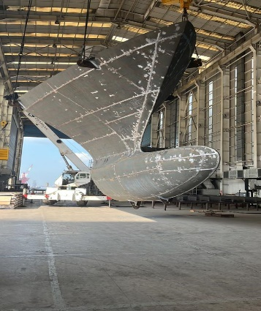
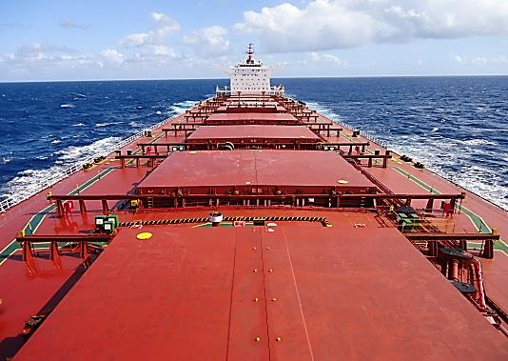
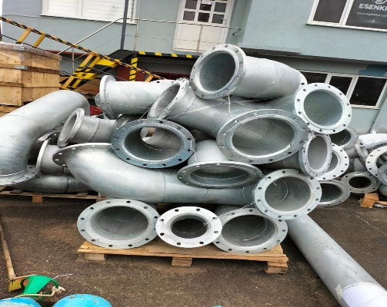
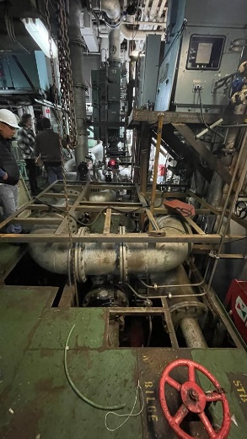
T H E C O M P A N Y
Powered by
T A Ş G E M
with its expert and experienced team, has been established on 2012 to provide reliable and permanent solutions in SHIP HULL CONSTRUCTION REPAIR SERVICE as well as OUTFITTINGS, BWTS INSTALLATION, PIPING WORKS
The reliability and experience of our founders which have achieved with their proffessional business life nearly forty years is our most important value.
T A Ş G E M
Head office and our workshop is established in Tuzla-Istanbul where is shipyard region of Turkey to able provide faster service and able be accessible at all times.
We sure that we will reduce running cost of your ships by providing you high quality service and the highest safety performance with our well trained technical team members and our past experience.
YOUR FRIENDLY MARINE SERVICE

Slide 3
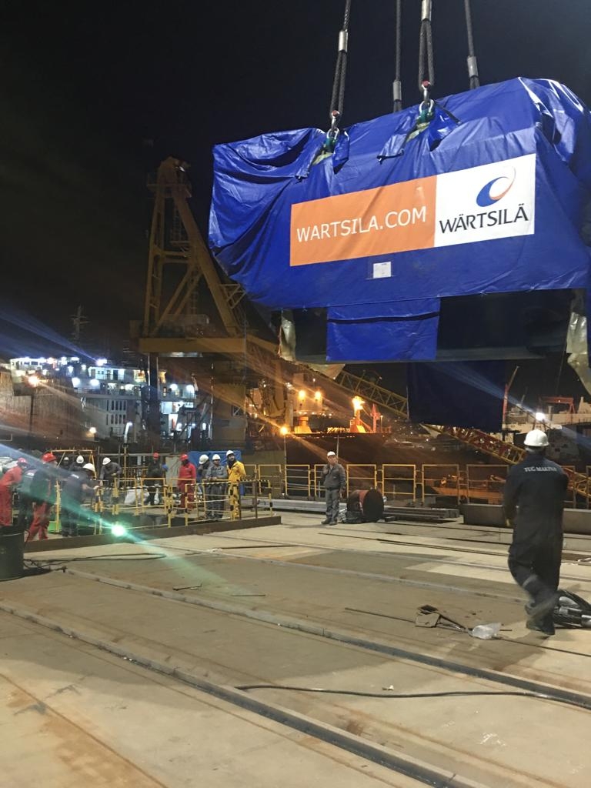
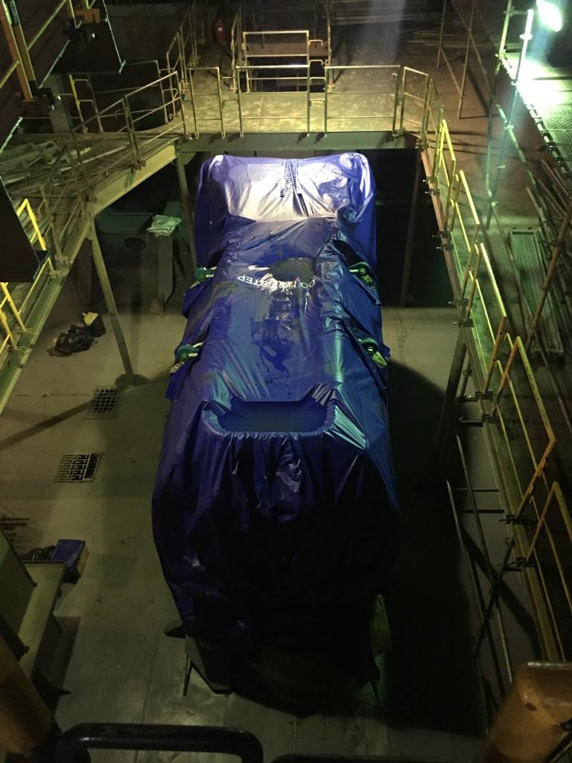
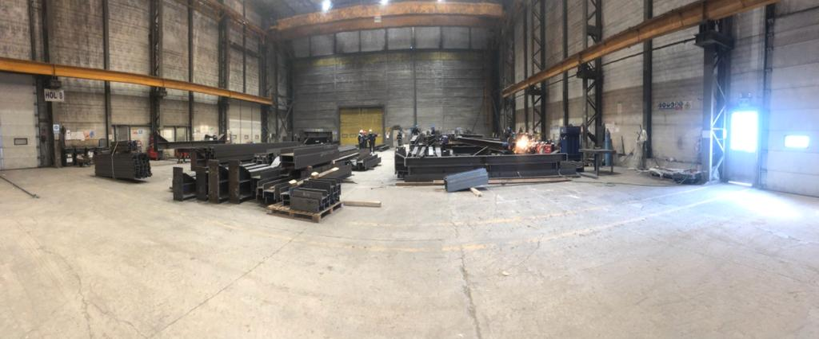
T H E C O M P A N Y
Powered by
T A Ş G E M technical specialists are equipped with the right competence and tools to provide you the best effective services soever you need.
We know very well that the company organizations are not same as the others and the needs and visions of our customers are different.
'' LISTENING and DIALOGUE '' IS THE BASIS OF ALL OUR ACTIVITIES

Slide 4
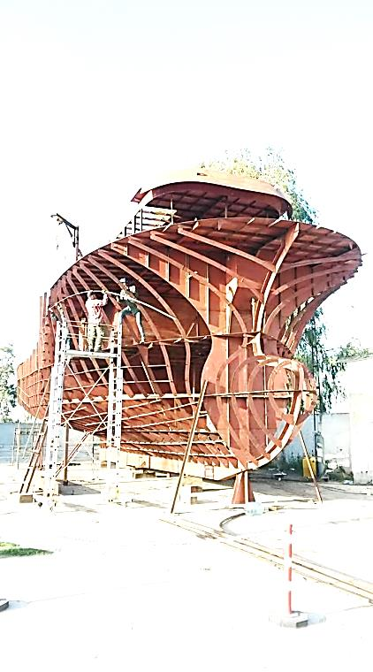
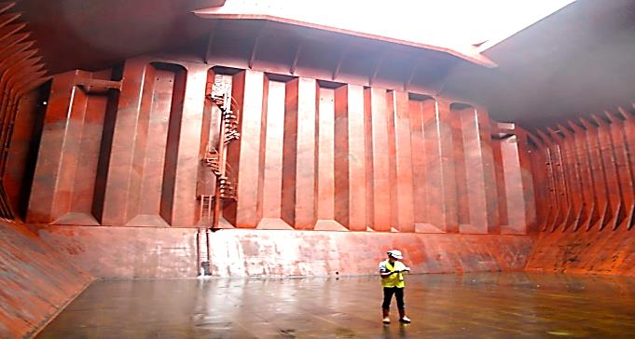
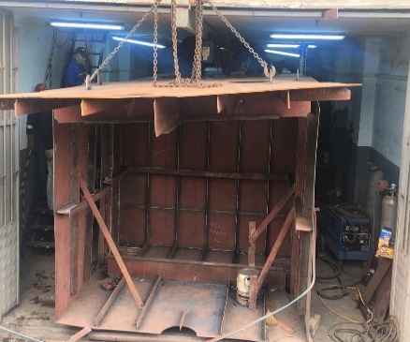
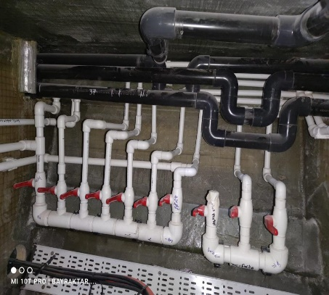
O U R B U S I N E S A R E A S
Powered by
The organization of T A Ş G E M was formed on the main subjects given below.
Ship Hull & Outfitting Repair & Maintenance
BWTS Installation & Piping arrangement & Commissioning test
Bespoke Outfitting production
WE SERVE OUR EXPERTISE

Slide 5
Q U A L I T Y
Powered by
Client satisfaction is a key measurement of success for T A Ş G E M whose focus on delivering solutions in comply with rules and standards.
T A Ş G E M is ISO 9001 & 45001 & 14001 cetified company
We use a comprehensive Quality Management System to ensure that the client’s requirements are always fully met and often exceeded whilst ensuring that all work carried out is conducted in a safe, planned and controlled alongside this commitment we meet the required national and international regulations.
Our procedures are flexible and able enough to adapt for any specific client, standard or legal requirement.
Offering a wide variety of products and services we take pride in its expertise by delivering what is needed, on time and in budget.
CLIENT SATISFACTION IS A KEY MEASUREMENT OF SUCCESS FOR US

Slide 6
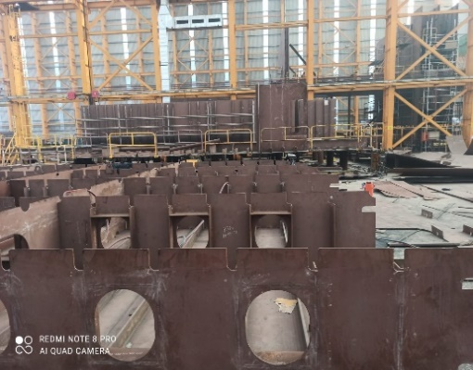
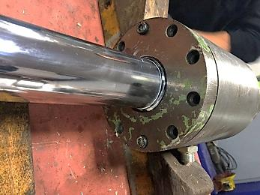
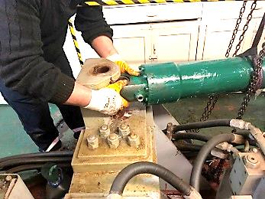
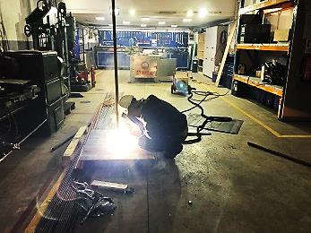
S H I P H U L L & O U T F I T T I N G & P I P I N G R E P A I R I N G
Powered by
We collect all your repair and maintenance jobs belonging to the DECK and MACHINERY PIPING in one hand.
We can provide repair, maintenance or manufacturing service on Ship Hull Construction, Ship’s Deck Equipment (outfittings), piping systems in various materials from steel to aluminium, from cast iron to stainless steel.
1 COMPANY 1 SERVICE FROM ENGINE TO HULL

Slide 7
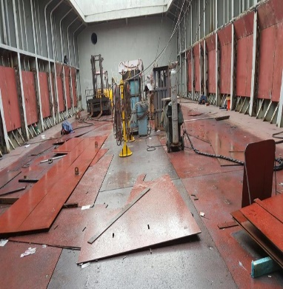
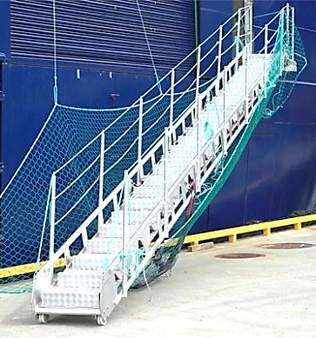
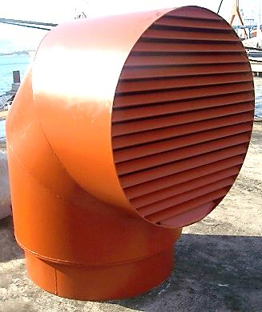
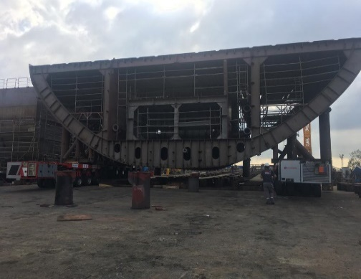
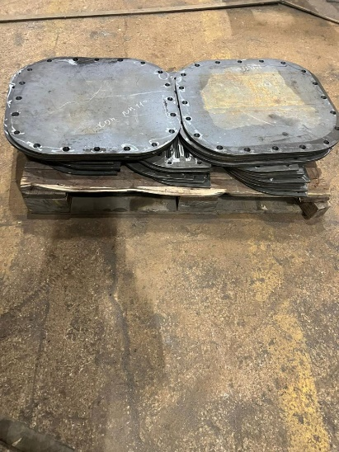
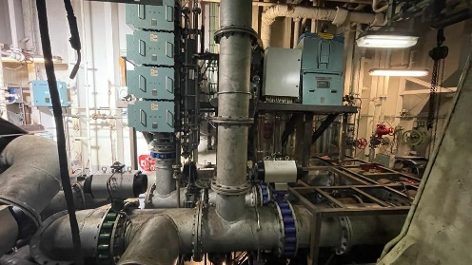
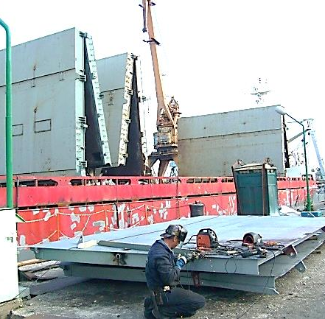
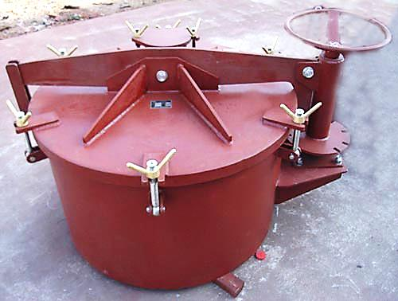
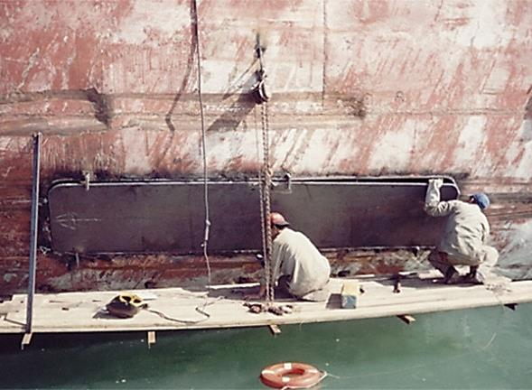
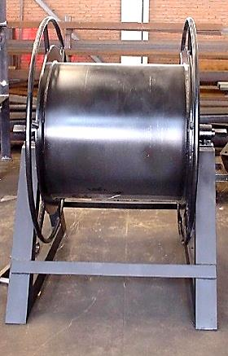
S H I P H U L L & O U T F I T T I N G & P I P I N G R E P A I R I N G
Powered by
1 COMPANY 1 SERVICE FROM PIPING TO HULL

Slide 8
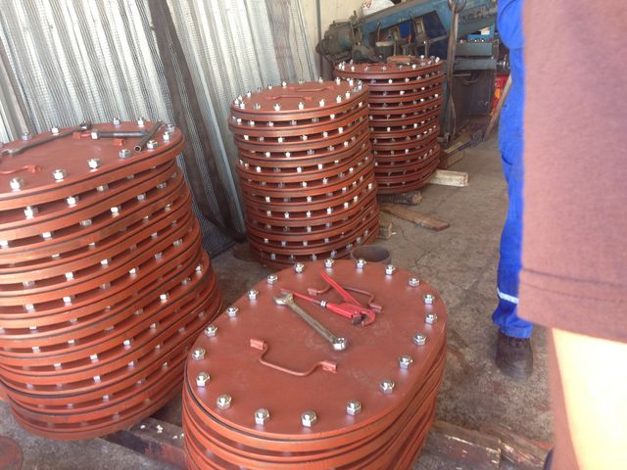
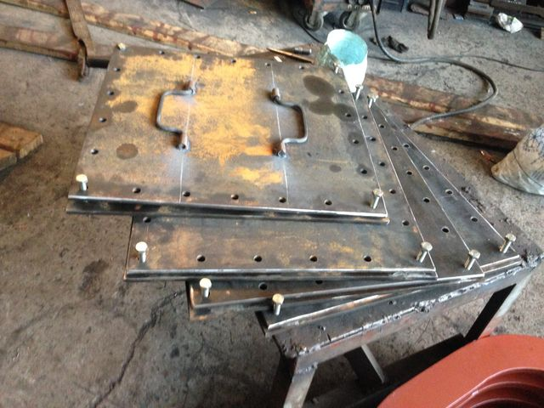
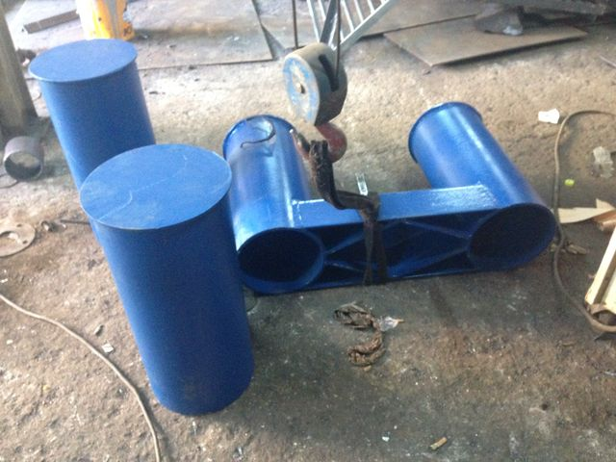
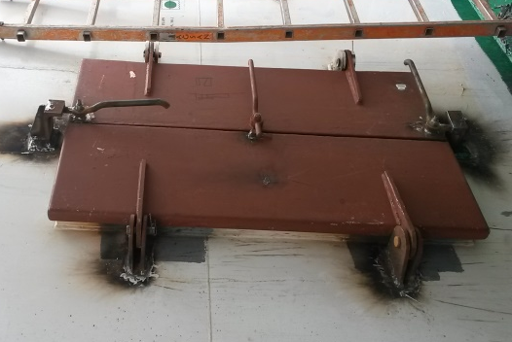
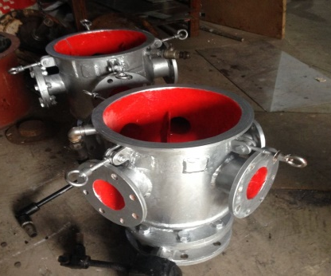
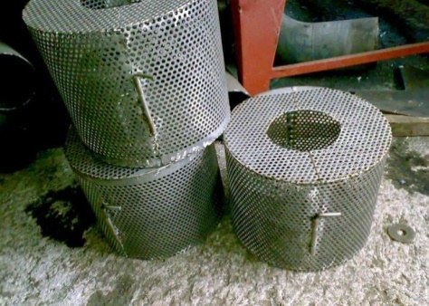
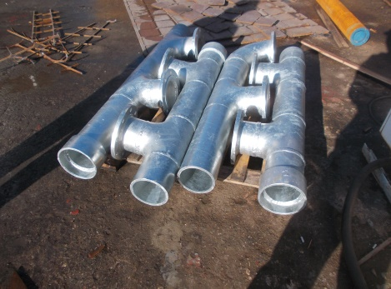
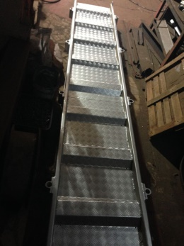
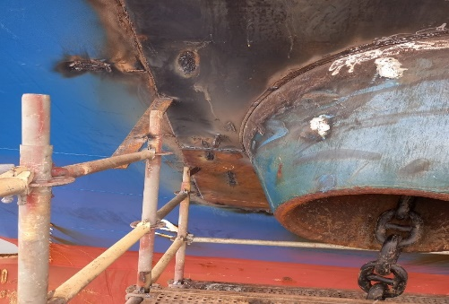
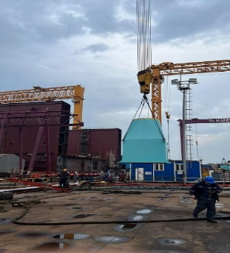
S H I P H U L L & O U T F I T T I N G & P I P I N G R E P A I R I N G
Powered by
1 COMPANY 1 SERVICE FROM ENGINE TO HULL

Slide 9
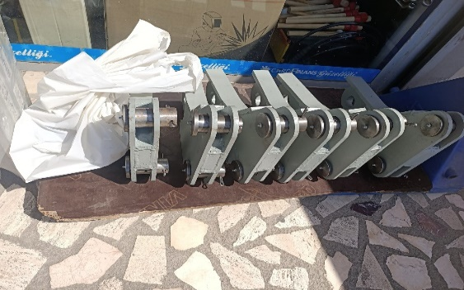
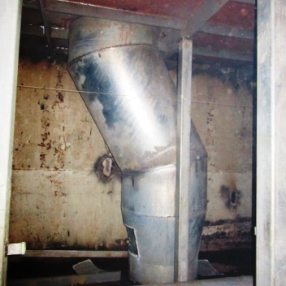
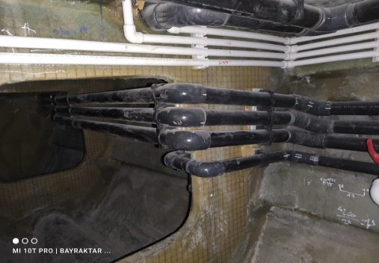
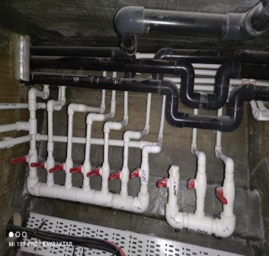
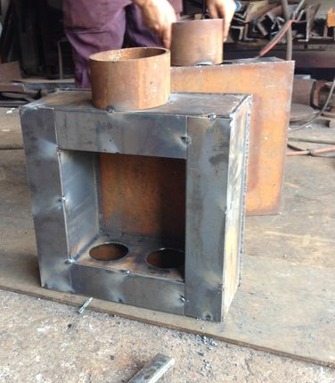
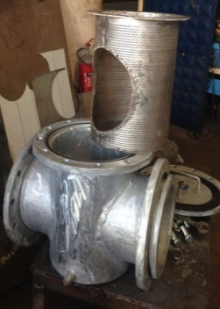
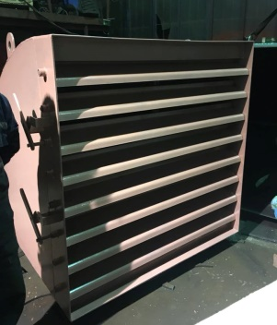
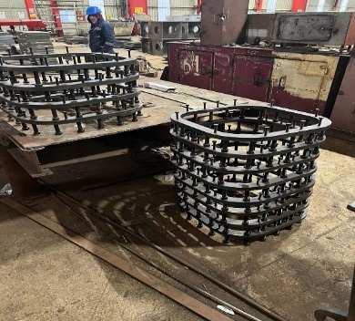
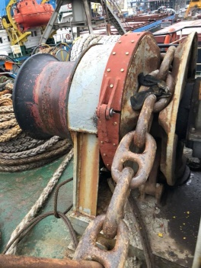
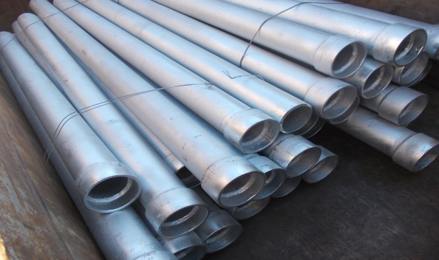
S H I P H U L L & O U T F I T T I N G & P I P I N G R E P A I R I N G
Powered by
1 COMPANY 1 SERVICE FROM ENGINE TO HULL

Slide 10
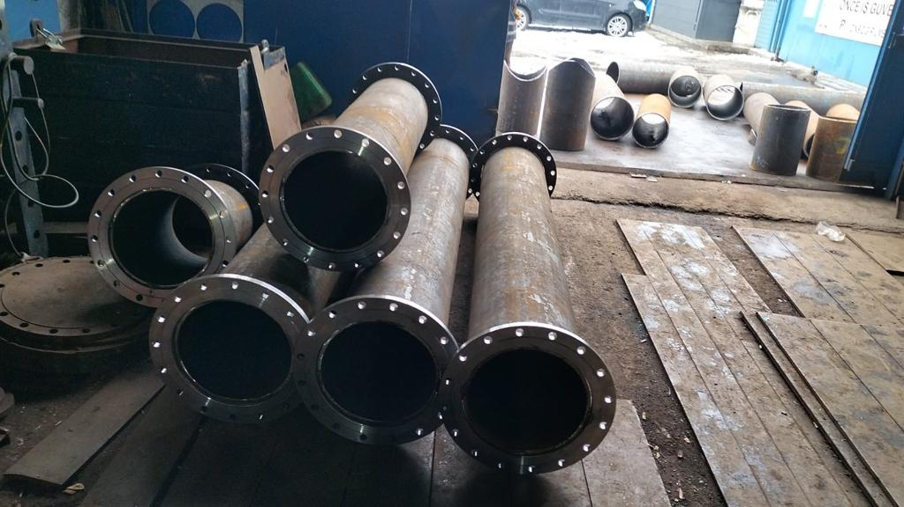
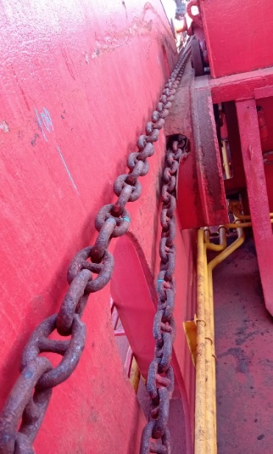
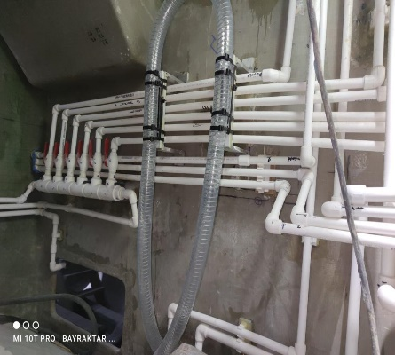
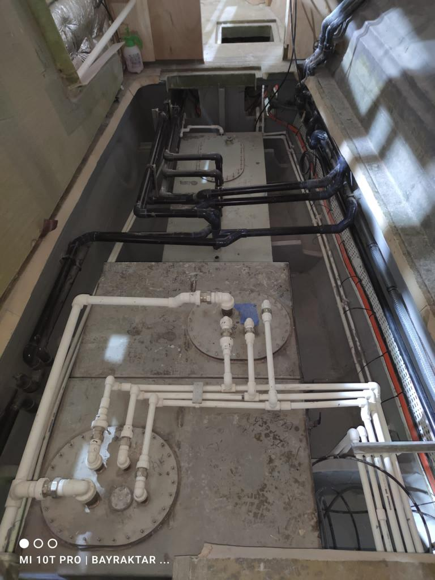
S H I P H U L L & O U T F I T T I N G & P I P I N G R E P A I R I N G
Powered by
We are providing better value for servicing budgets by maximizing repair opportunities and minimizing spare parts replacement
We are simply faster and on a 7/24 basis
Transparency and partnership
Service warranty for all jobs
We are good in the development and application of new repair technologies and solutions that meet our Customer’s needs, we are accountable to them
Technology builds the back drop of our activities. All of our service solutions are technically sound and reliable
High reliability and lower service cost
SERVICE WARRANTY FOR ALL JOBS

Slide 11
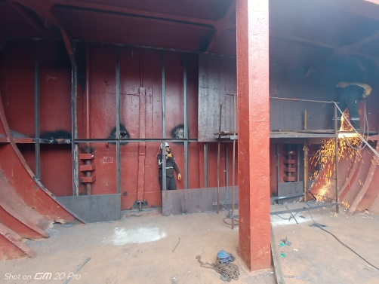
S H I P H U L L & O U T F I T T I N G & P I P I N G R E P A I R I N G
Powered by
7x24 HOUR ON-SITE & ON-SITU REPAIRING SERVICE

Slide 12
Powered by
EVLİYA ÇELEBİ MAH. GENÇ OSMAN CAD. CÖMERT SOK. GİPTAŞ SANAYİ SİTESİ A BLOK NO:44
34940 TUZLA – ISTANBUL – TURKIYE
www.TAS-GEM.com info@TAS-GEM.com
+90(545) 961 16 03 +90(546) 569 60 64

